Slide 1

Habit Forge CS 5610 - Web Development
Final Project: Iterating your full stack application with design, accessibility and usability
Aniket Nandi (002598522)
Neil Wang (002375301)

Slide 2
Objective
Build a full-stack habit tracking app with Node.js, Express, MongoDB, and React with Hooks
Allow users to create habits, log completions, and track streaks and weekly completion percentages
Support analytics with sort, filter by date range, and personal weekly goal targets
Incorporate design principles, accessibility standards, and usability improvements based on participant feedback

Slide 3
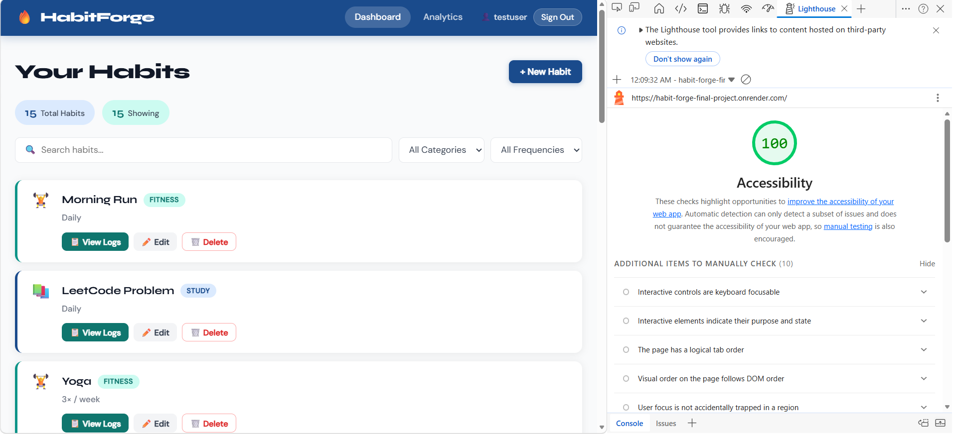
Lighthouse Report Dashboard

Slide 4
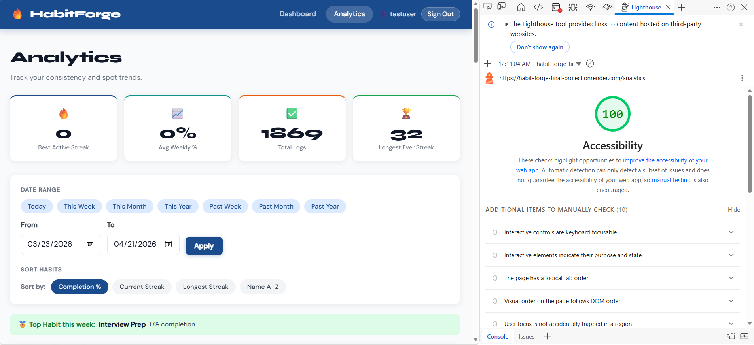
Lighthouse Report Analytics

Slide 5
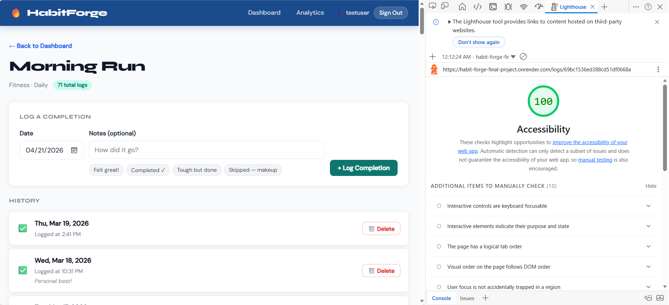
Lighthouse Report Log View

Slide 6
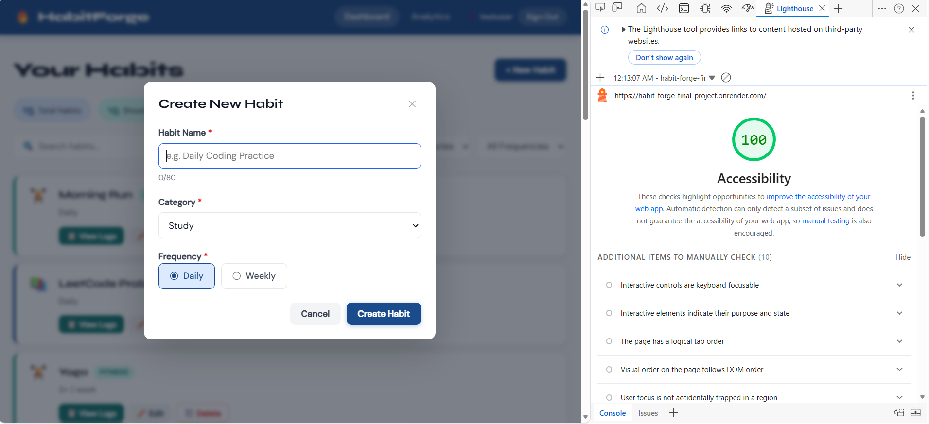
Lighthouse Report Habit Form

Slide 7
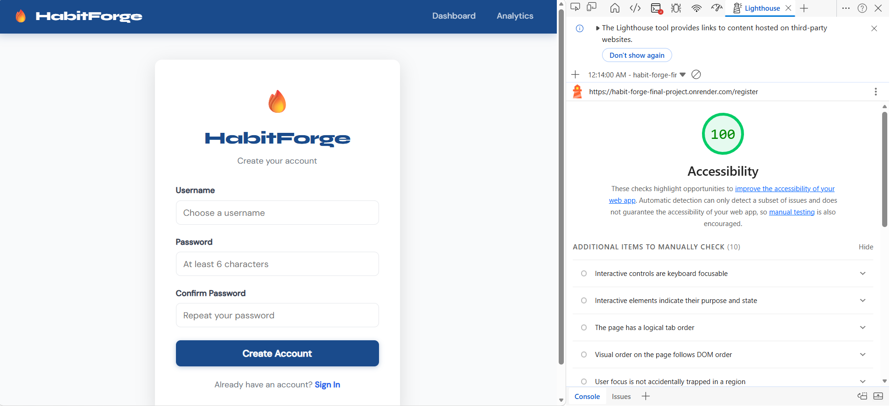
Lighthouse Report Login/Register

Slide 8

Design and Mockups
5 screens designed: Dashboard, Add/Edit Habit, Log View, Analytics, Navigation
Wireframes focused on habit cards, log history, and analytics progress bars
React component-based layout with modal overlays and dynamic filtering

Slide 9
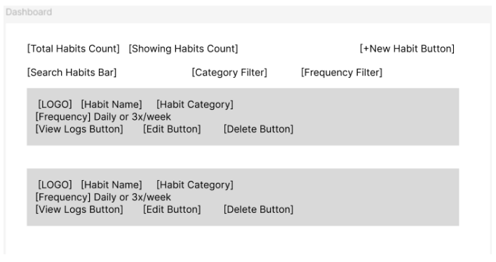
Design and Mockups

Slide 10
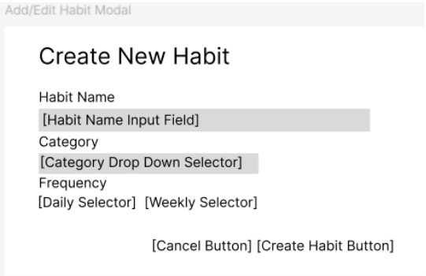
Design and Mockups

Slide 11
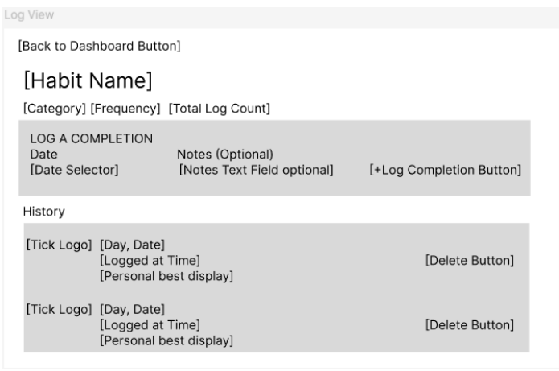
Design and Mockups

Slide 12
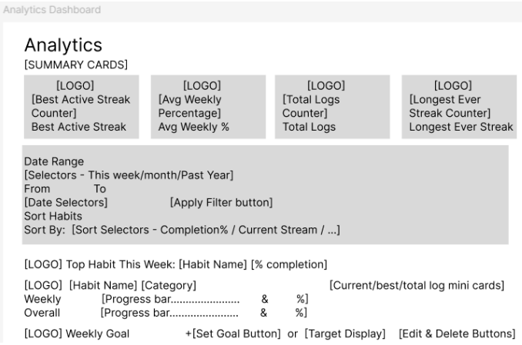
Design and Mockups

Slide 13
Technologies used
Node.js + Express (REST API backend)
MongoDB native driver (3 collections: habits, logs, goals)
React 18 with Hools + React Router v6 (client-side rendering)
ESLint + Prettier + Vite (build tool) + PropTypes
Deployed on Render (backend Web Service + frontend Static Site)
Passport.js + bcrypt + express-session (authentication)
Syne + DM Sans (typography pairing)

Slide 14
What Makes This Project Different?
Full analytics engine with streak calculation, weekly completion %, and date range filtering
3 MongoDB collections with full CRUD split between both team members
2046 synthetic records with realistic streak patterns, duplicate prevention and batch seeding
100% Lighthouse accessibility score across all pages
Full keyboard navigation with skip-to-content link and Escape key modal support
Usability study with 6 participants informed analytics filter improvements, google sso, and quick-fill log notes

Slide 15
What we are proud of.
Clean modular architecture: 12 React components each with own file and CSS, separate route files
Full CRUD on 3 MongoDB collections with proper indexing, validation, and cascade deletes
Deployed on Render with VITE_API_URL environment variable handling for production API calls
Realistic seed data with 2046 logs, streak patterns, duplicate prevention, and MongoDB indexes
100% Lighthouse accessibility score with zero errors or warnings
Typography pairing using Syne display font and DM Sans body font
Iterative design improvements driven by usability study findings

Slide 16
What we struggled the most with
ESLint flat config with Prettier plugin on Windows – LF vs CRLF line ending conflicts required .gitattributes fix
Vite proxy only works in development – solved with VITE_API_URL environment variable for production
Merge conflicts from coordinating commits between team members across different machines
Fixing color contrast across teal and orange badge components to meet WCAG AA standards

Slide 17
Demo
Project Demo Video - https://youtu.be/UJ4qNQq3BXg
Project GitHub Repo - https://github.com/aniketnandi/Habit-Forge/tree/final-project
Project Live Site - https://habit-forge-final-project.onrender.com

Slide 18
Takeaways
Separate backend concerns early – modular routes and collections make CRUD ownership clear
React with Hooks and component-per-file structure keeps the frontend clean and maintainable
Team coordination matters – always test locally before deploying and coordinate commits carefully to avoid merge conflicts
Design, Usability, and Accessibility matter!

